Slide 1
R.M. Schulze Family Heart and Stroke Critical Care Center Project Update
4.16.26

Slide 2
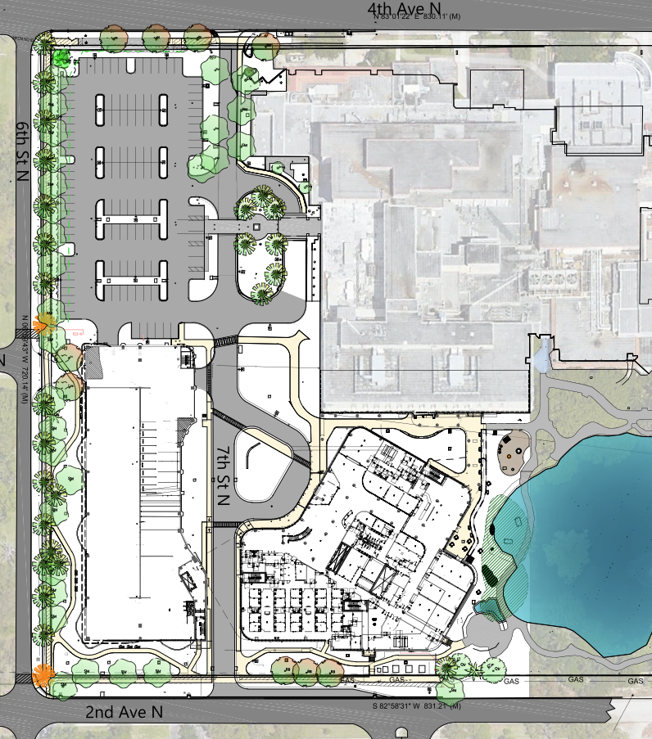
Current Site Status &
Upcoming Work

Slide 3
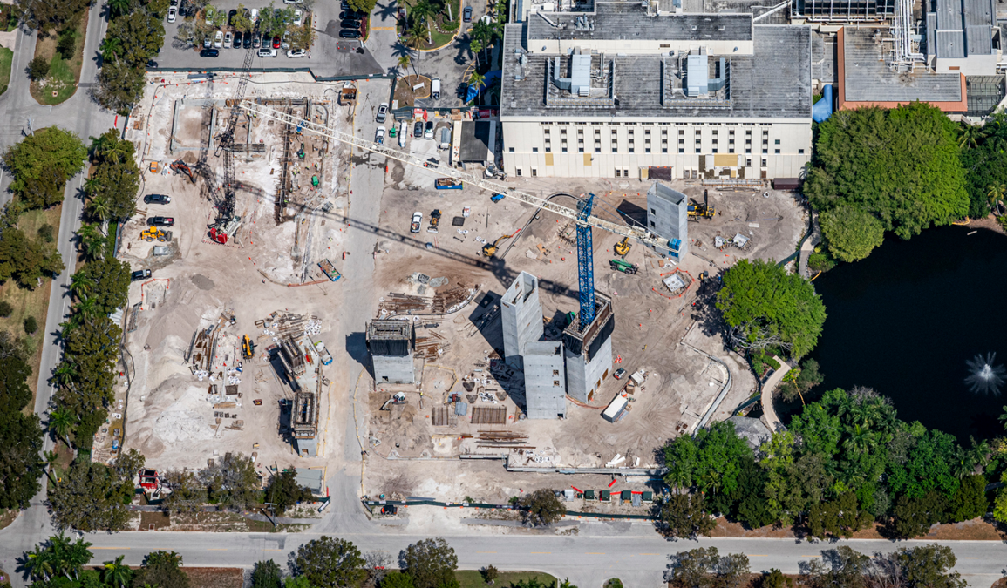
Current Construction Activities
Foundation work nearing completion
Elevator and stair towers nearing completion
Underground utilities continuing
Structural steel erection started
Precast erection on parking garage starting up
Multiple active cranes onsite

Slide 4
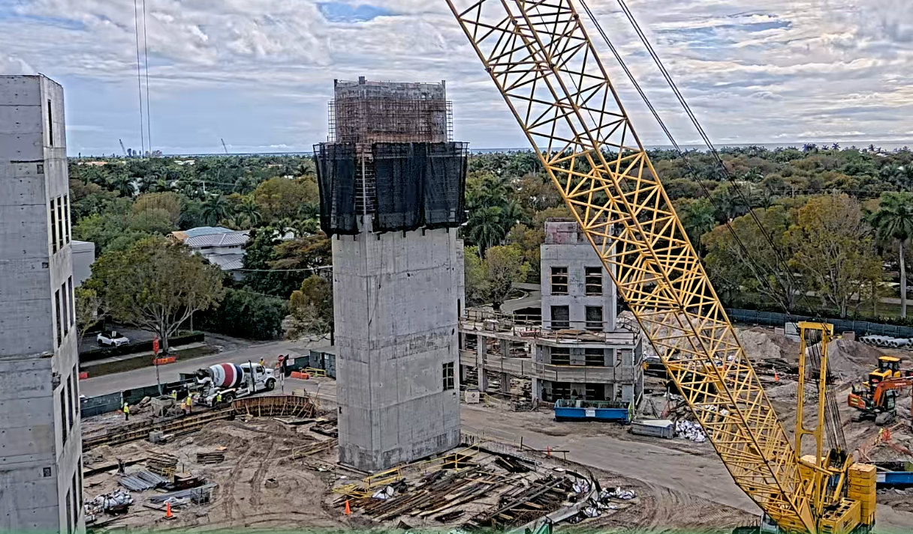
Upcoming Work Activities
April
Start steel erection
Start parking garage precast erection
Complete Elevator C shaft
Complete foundations
Complete parking garage Stair A & Elevator A shafts
Continue underground utility work
Increase in trucking traffic
May
Continue steel erection & detailing of connections
Continue precast erection
Start slab on deck floor pours
Start sprayed fireproofing
Increase in trucking traffic
June
Continue steel erection & detailing of connections
Continue precast erection
Continue slab on deck pours
Continue sprayed fireproofing
End of month- Start exterior & interior wall framing

Slide 5
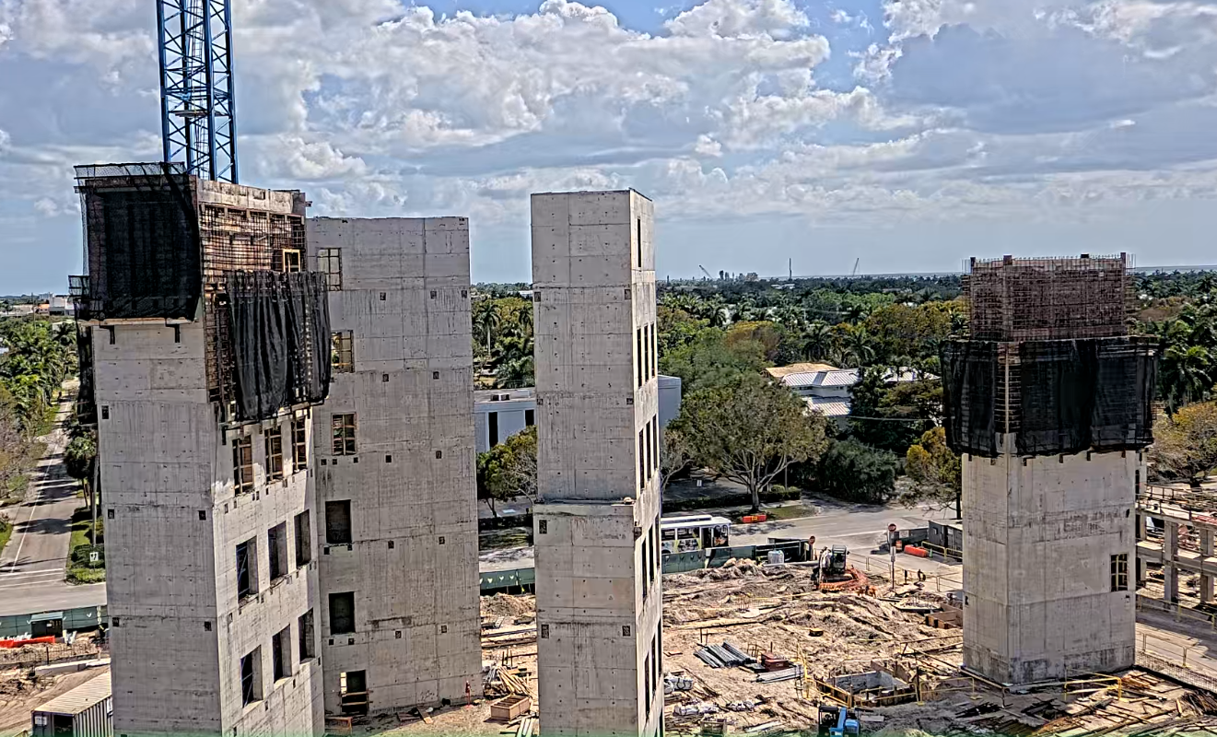
Reasoning for NCH issuance of local resident project update letter
A request has been submitted to the city building dept for consideration on the following changes to construction work hours and days:
Increase work hours onsite for steel erection from M-F 8am-4pm to 7am-5pm and allow steel erection to occur on Saturdays from May-August
Start concrete deck pours in the early overnight hours of 2am from May-August
Benefits of proposed changes to the project & local residents:
Reduces the number of concrete trucks on local roadways during normal business hours
Completing the structural steel building frame prior to the onset of peak hurricane season
Remove 2 of 3 large cranes onsite prior to the onset of peak hurricane season
(3) week pick up on the duration of steel erection with additional work hours and days
Noise mitigation strategies during early overnight work include:
Changing backup alarms on concrete trucks from beeping to swoosh sounds
Constructing a noise barrier / acoustic panel enclosure at concrete pump truck
Use of battery powered equipment in lieu of gas powered where applicable

Slide 6
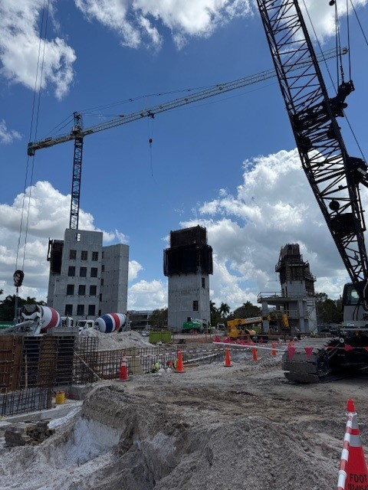
What to expect over the next 3 months around the construction site

Slide 7
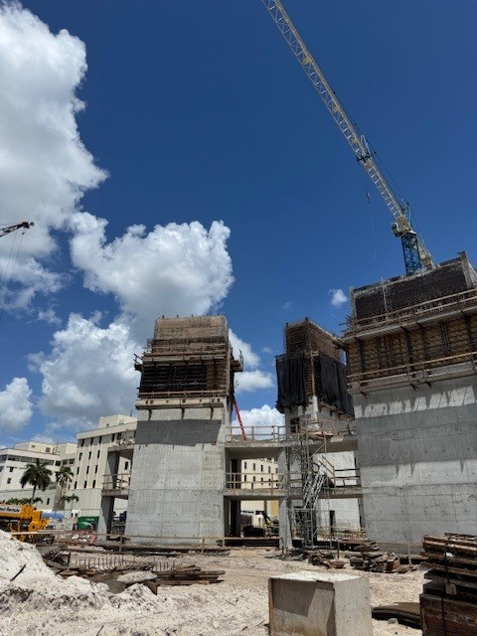
What to Expect: May – July 2026
Increased construction vehicle traffic coming from 41 turning west on 2nd then into the jobsite – daily (concrete trucks, steel deliveries, precast deliveries, pump trucks, dump trucks, etc.)
Flagmen will be used to direct construction traffic entering and exiting the project site.
Cranes in operation onsite for precast panels and steel erection. Early overnight / morning concrete pours.
Precautions will be taken to minimize noise onsite during concrete deck pours during early work hours.
Local residents may hear a combination of horn or whistle sounds when the crane is actively hoisting loads across the site. This is an OSHA safety requirement for workers onsite.
An increase in onsite construction workers. A parking shuttle will continue to transfer construction workers from offsite parking areas to the construction site.

Slide 8
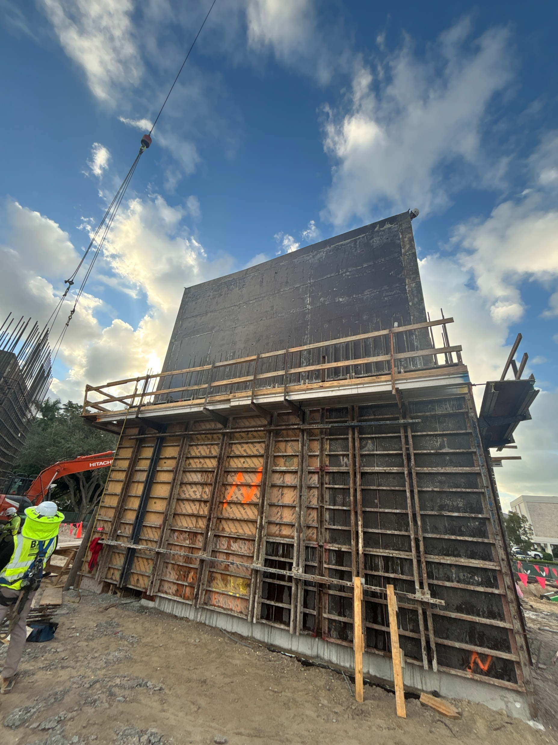
Schedule Update

Slide 9
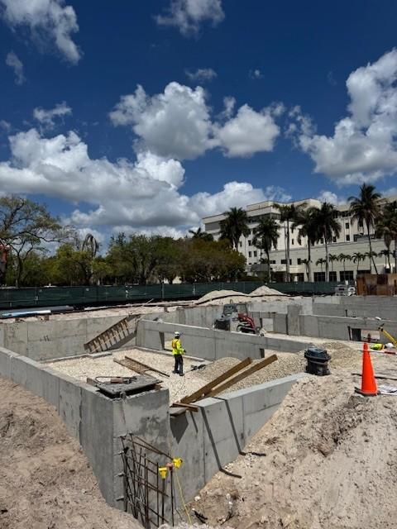
Current Construction Schedule Milestones
(Subject to Change)
Parking garage
Foundations complete – 2nd quarter 2026
Precast structure erected – 3rd quarter 2026
Building complete – 4th quarter 2026
Landscaping installation – 4th quarter 2026
(installation will occur in multiple phases)
Heart Vascular & Stroke Institute
Foundations complete – 2nd quarter of 2026
Fixed crane erected – 1st quarter of 2026
Steel erection complete - 3rd quarter of 2026
Exterior enclosed – 4th quarter of 2026
Install elevators – 2nd quarter of 2027
Permanent Power – 2nd quarter of 2027
Commissioning of MEP Systems - 3rd quarter of 2027
Building complete – 3rd quarter of 2027

Slide 10
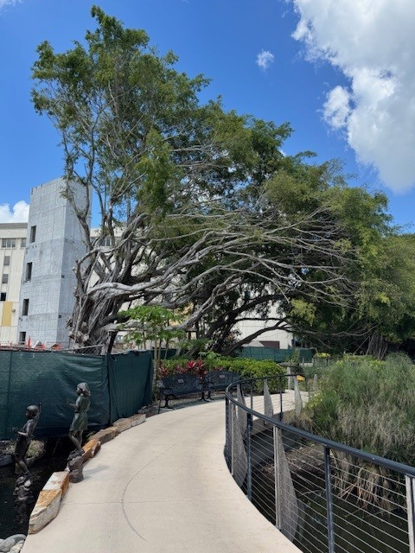
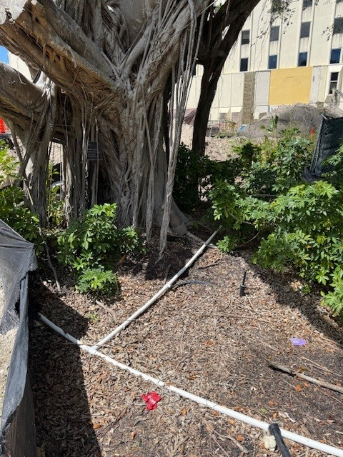
ALD - Ficus Tree Update
Site updates to maintain the tree during construction:
Site retaining wall was moved back to benefit the root system
Tree was treated for whiteflies
Supplemental irrigation was added
Tree has been trimmed per arborists recommendation’s
Tree will receive additional trimming along boardwalk to correct a public safety issue with uneven load distribution
Supplemental branch support will be added at several locations

Slide 11
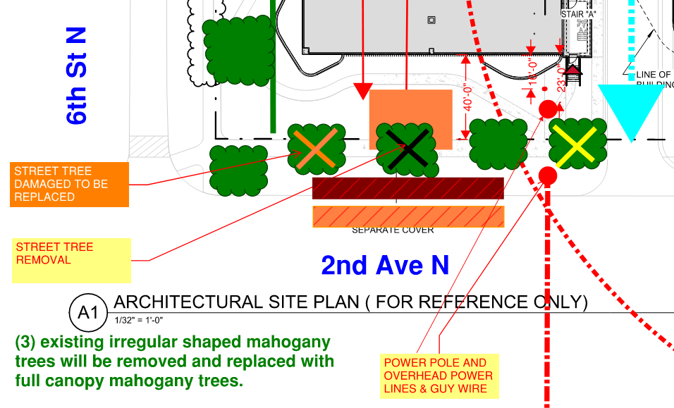
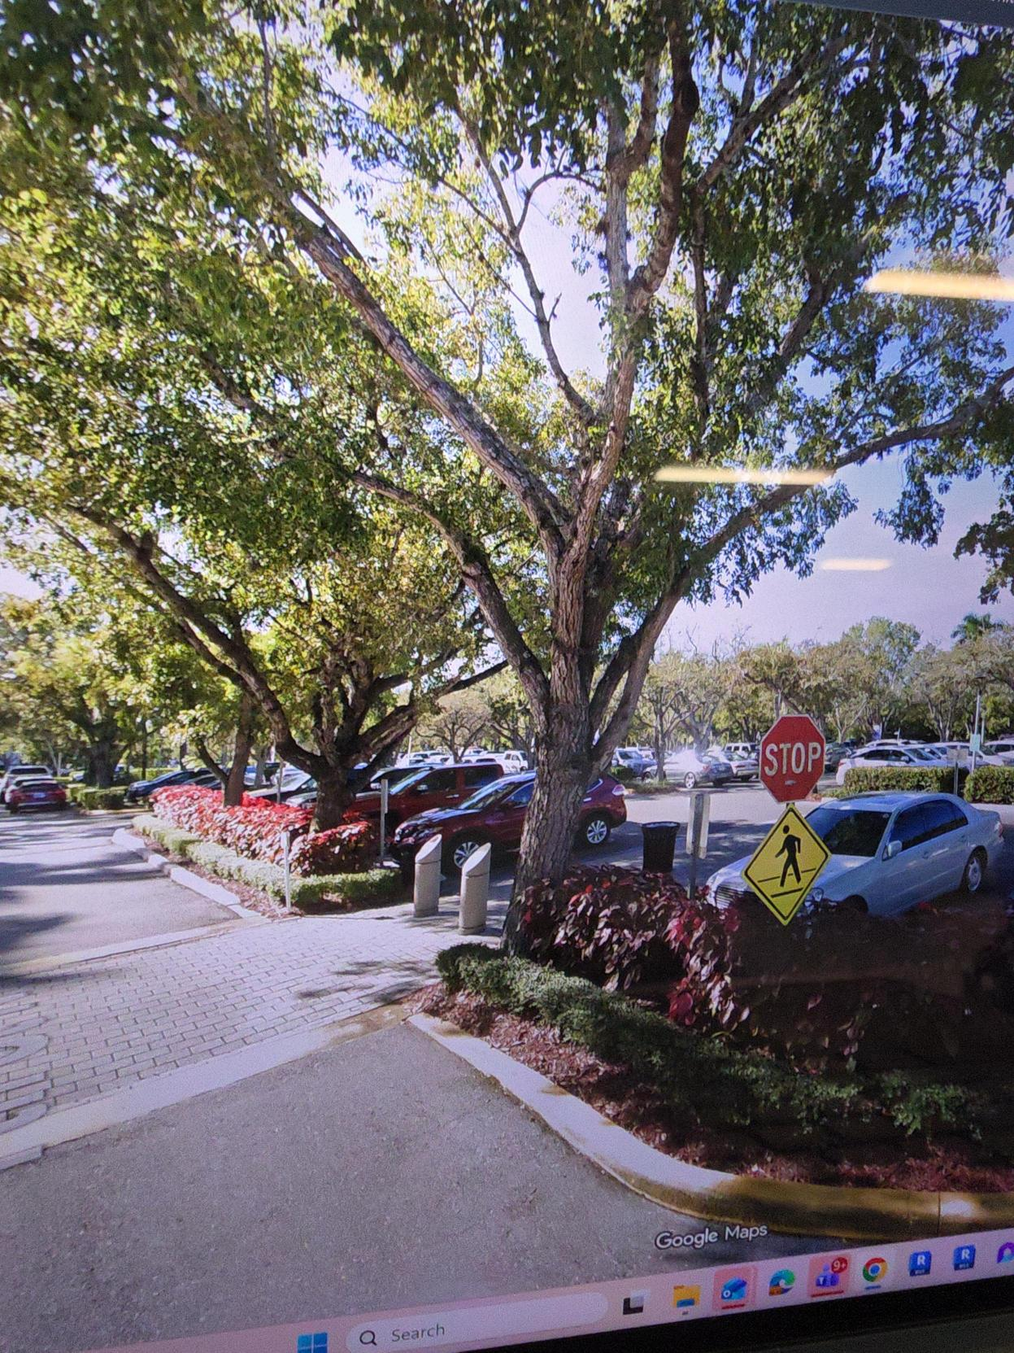
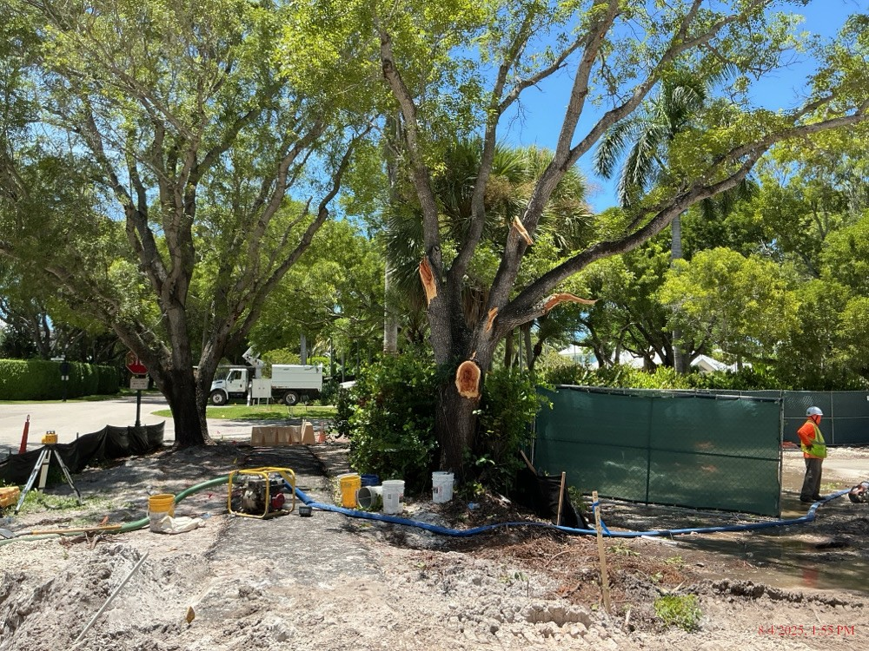
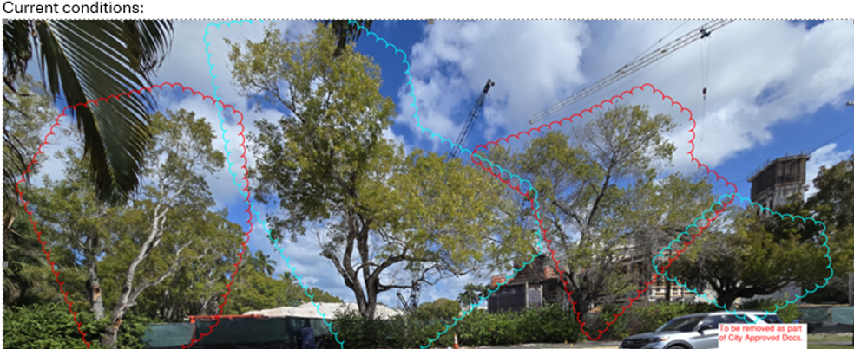
ALD - Update on 2nd Ave N Tree line
2nd Ave N Tree Improvements
Replacing damaged & partial canopy mahogany trees w/ full canopy mahogany trees (3) total
Reusing & replanting existing trees from the parking lots main drop off loop area
Transplanted trees will provide a better full uniform canopy along the street line

Slide 12
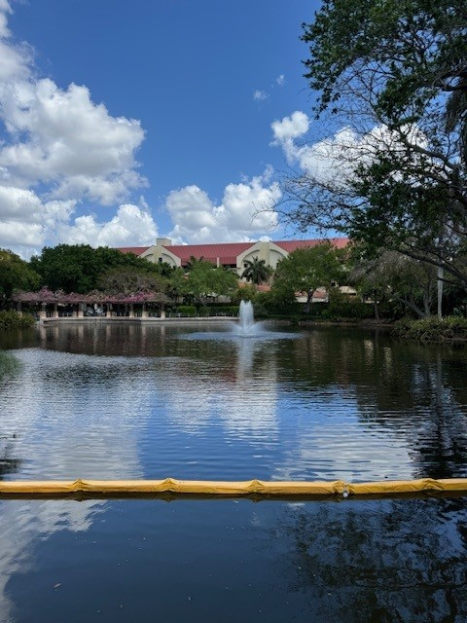
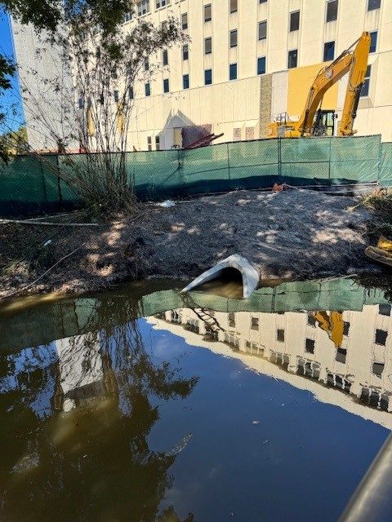
APEX - Lake Conditions
Lake updates
New construction drainage outlet work is complete
Winter temperature impacts to fish within the lake
All work in and around the lake is performed within city and state requirements
Evaluation and monitoring of lake conditions is ongoing

Slide 13
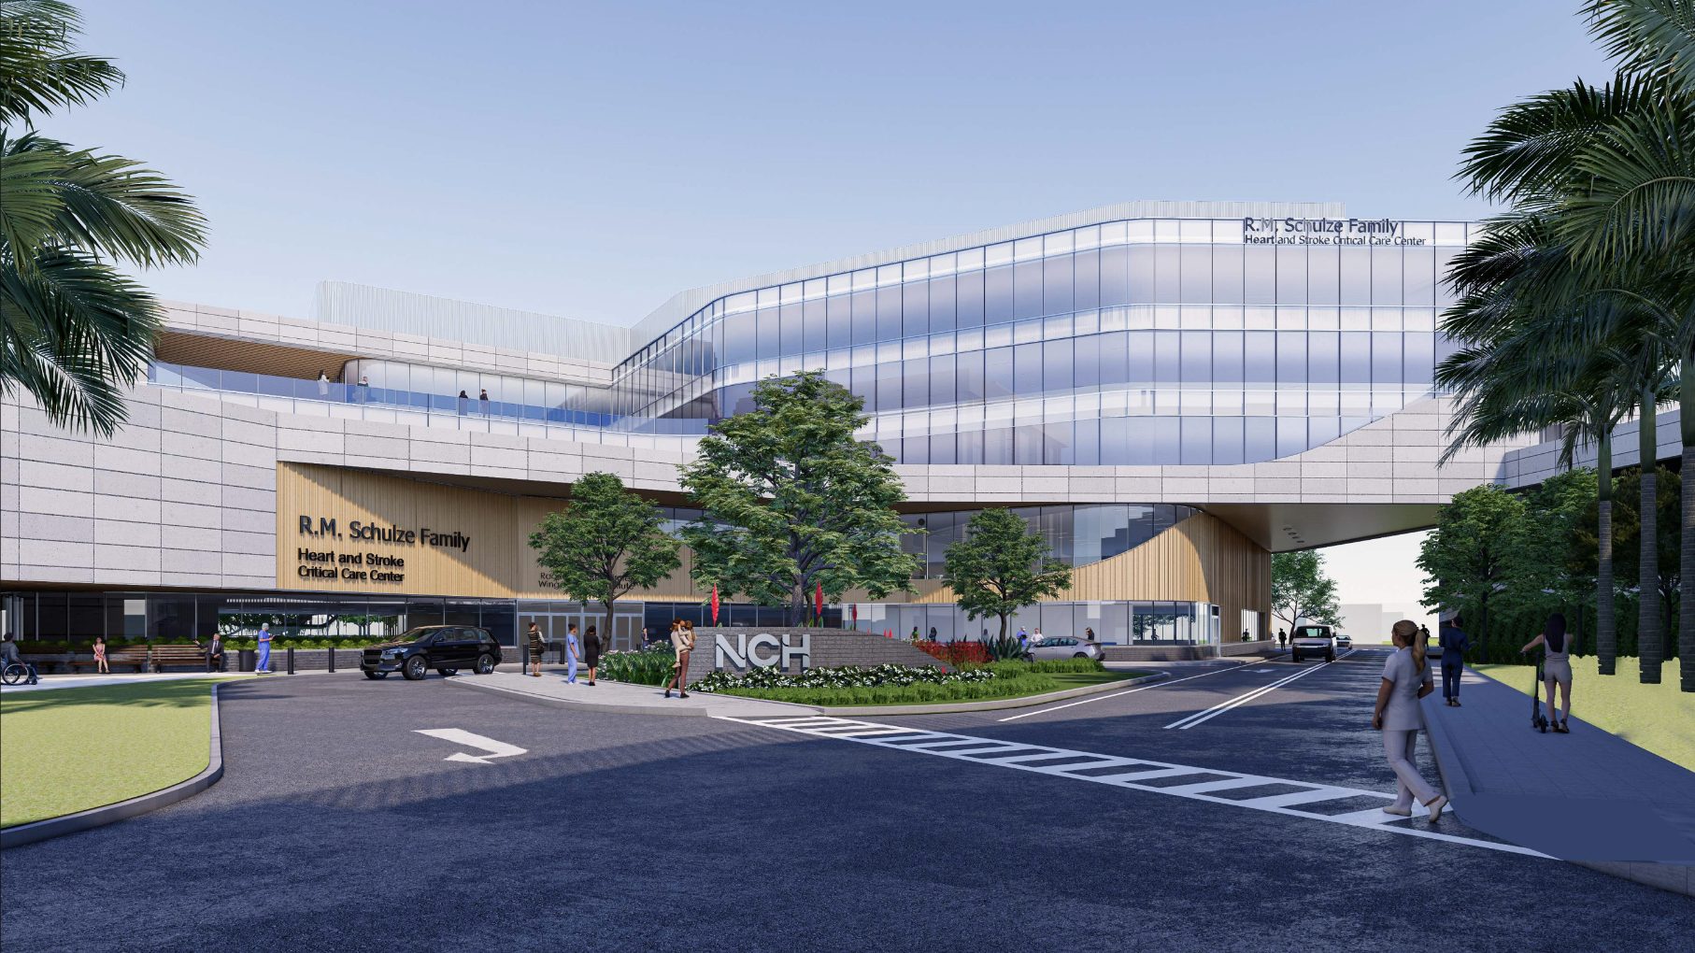

Slide 14
To learn more visit:
criticalcareinnaples.com
Project Contact Information
Matt Holliday
neighbors@nchmd.org
239-826-7864

Slide 15
THANK YOU

