Slide 1
R.M. Schulze Family Heart and Stroke Critical Care Center
Project Update
9.24.26

Slide 2
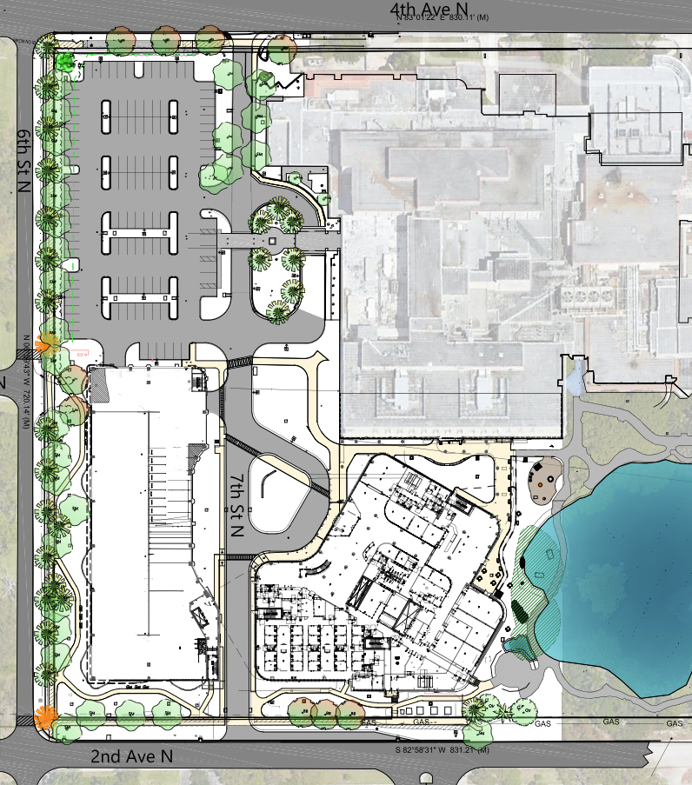
Current Site Status &
Upcoming work

Slide 3
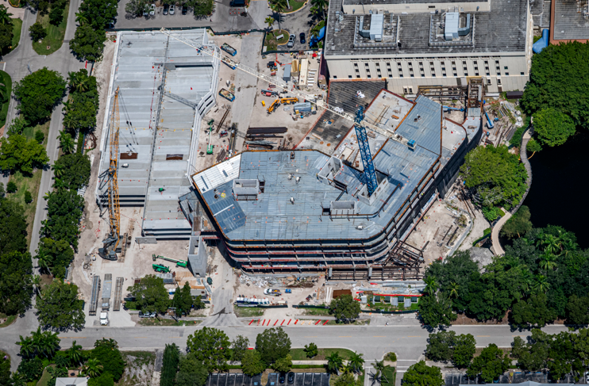
Current Construction Activities
Parking garage erection is complete; the crane is being demobilized by end of month. (2nd Ave street closure / mods).
Structural steel erection is complete.
Sprayed fireproofing is ongoing.
Concrete slab on deck placements are nearing completion.
Interior wall framing is continuing on all floors.
Mechanical, Electrical & Plumbing rough-in is ongoing on all floors.
Drywall install is ongoing at top of interior walls.
Underground utility work is ongoing.

Slide 4
Upcoming Work Activities
October
Complete steel erection
Complete sprayed fireproofing on structural frame
Continue interior wall framing
Continue interior MEP wall & ceiling rough-in
Continue interior drywall
Continue roofing installations
Start (CEP) Central Energy Plant piping runs to HVSI.
Start exterior curtain wall
Install buck hoist along exterior of building for material & manpower movement.
Continue parking garage MEP installations
November
Continue interior wall framing
Continue interior MEP wall & ceiling rough-in
Continue interior drywall
Start parking garage landscaping
Continue roofing installations
Continue parking garage MEP installations
Continue CEP piping work to HVSI.
Continue exterior curtain wall
December
Continue interior wall framing
Continue interior MEP wall & ceiling rough-in
Continue interior drywall
Continue parking garage landscaping
Continue roofing installations
Make CEP final connections to HVSI.
Install parking garage elevator
Continue exterior curtain wall

Slide 5
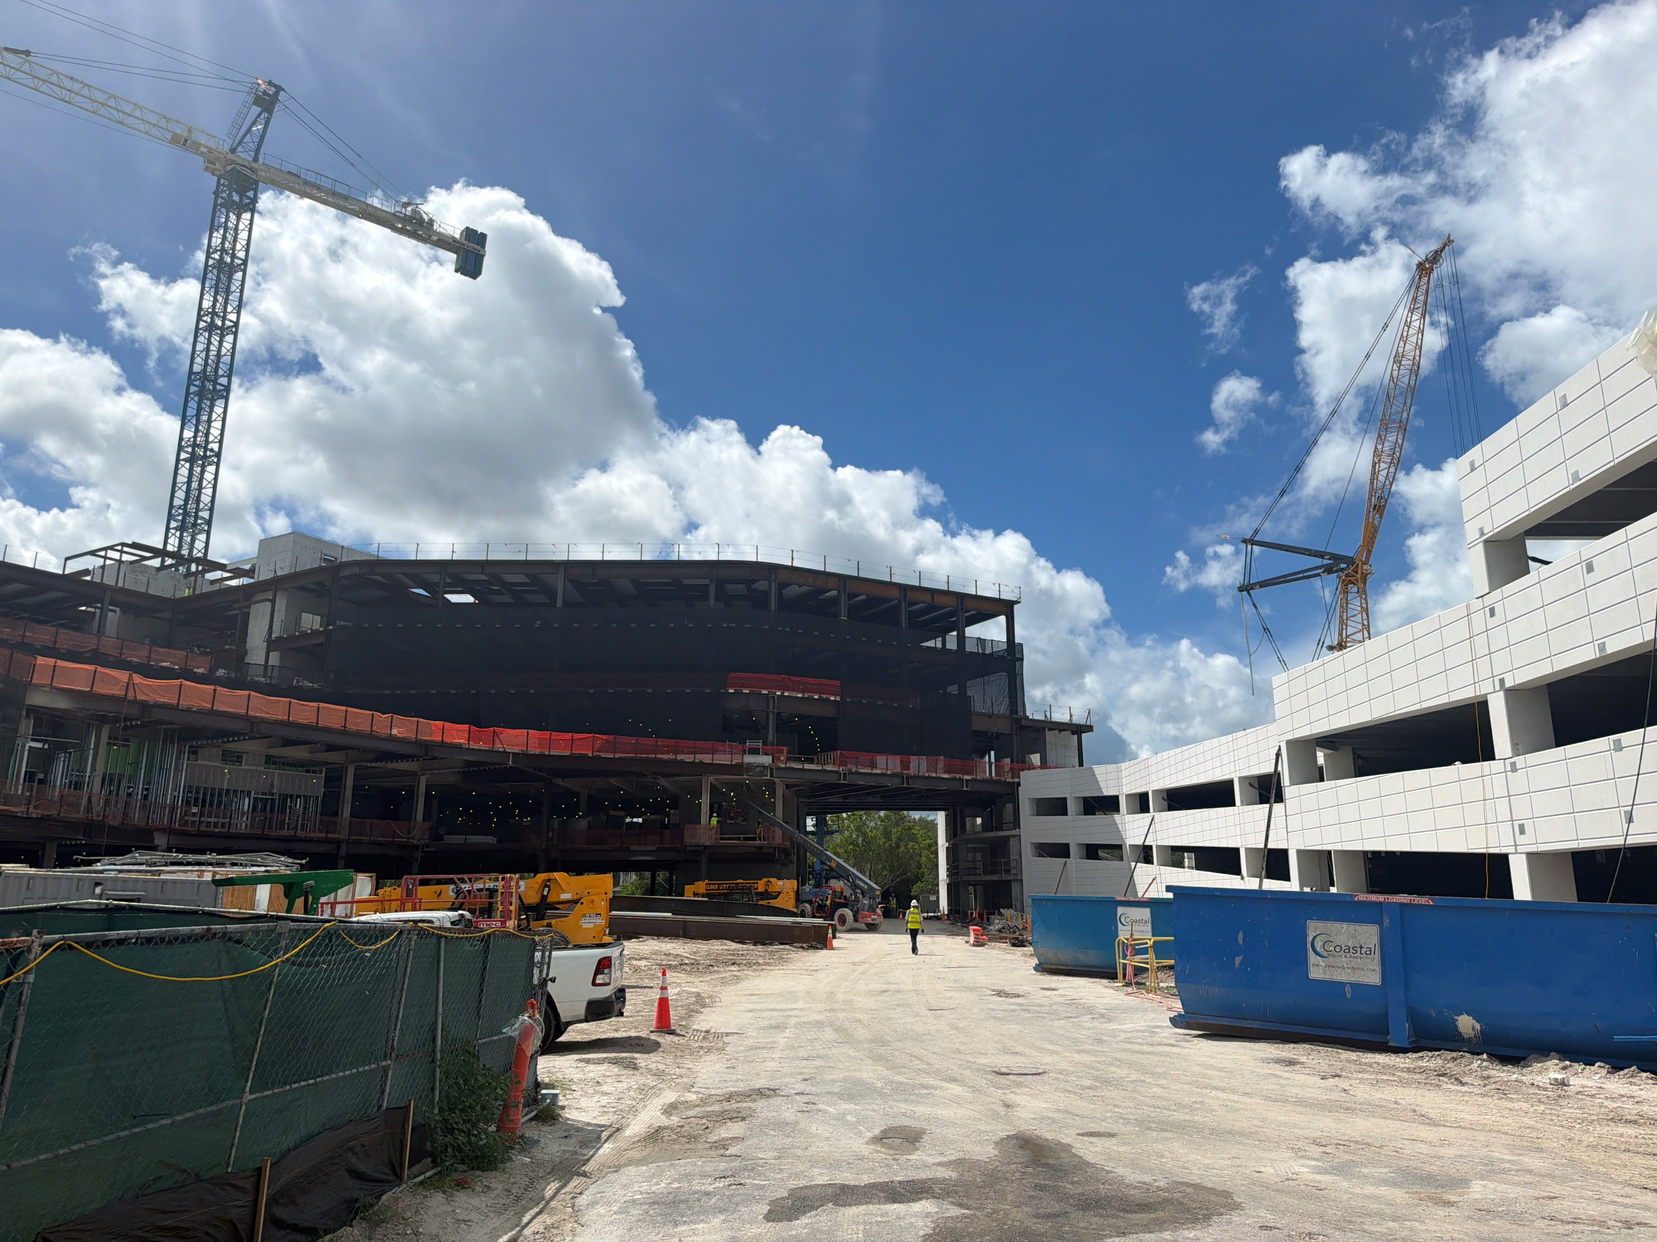
What to expect over the next 3 months around the construction site ?

Slide 6
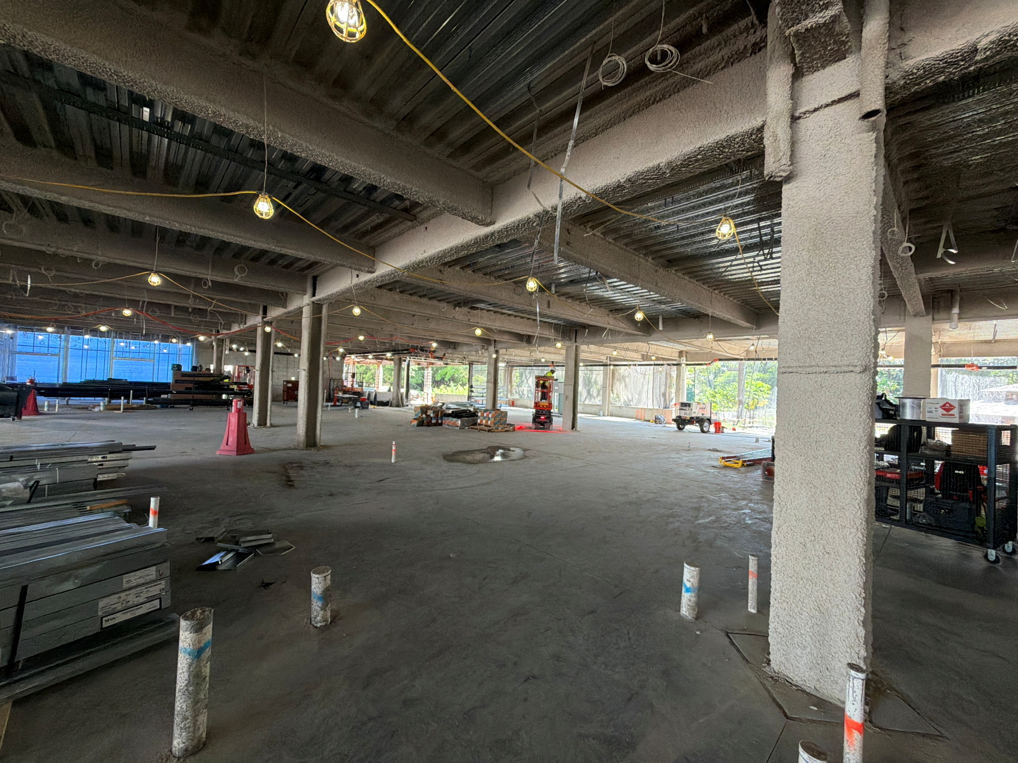
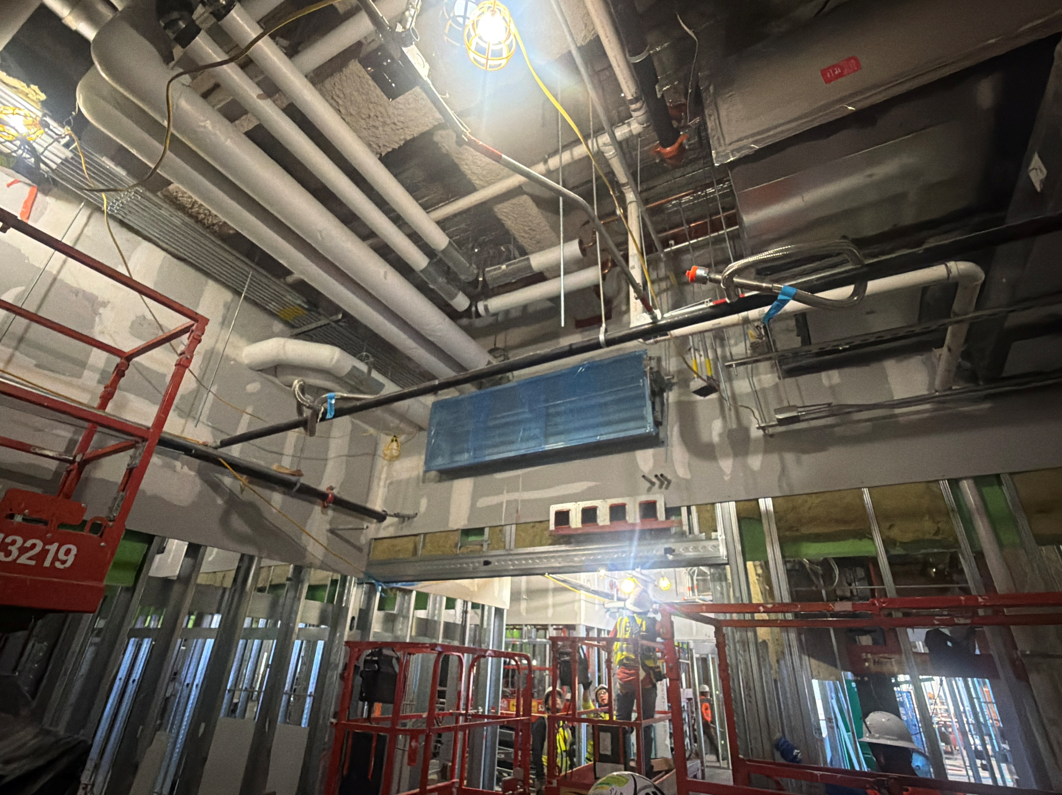
Expectations on site over the next 3 months
Continued construction vehicle traffic coming from 41 turning west on 2nd then into the jobsite – daily (curtain wall, drywall , studs, roofing & MEP construction material deliveries)
The fixed elevated crane will remain in use for several months in order to erect the curtain wall sections around the exterior of the building.
The buck hoist will be operational going up / down the exterior face of the building to move manpower & materials.
An additional mobile crane may be used to lift roof top equipment to the mechanical penthouse level.
Local residents may hear a combination of horn or whistle sounds when the crane is actively hoisting loads across the site. This is an OSHA safety requirement for workers onsite.
An increase in the amount of onsite construction workers to a peak of 300 +/-. A parking shuttle will continue to transfer construction workers from offsite parking areas to the construction site.

Slide 7
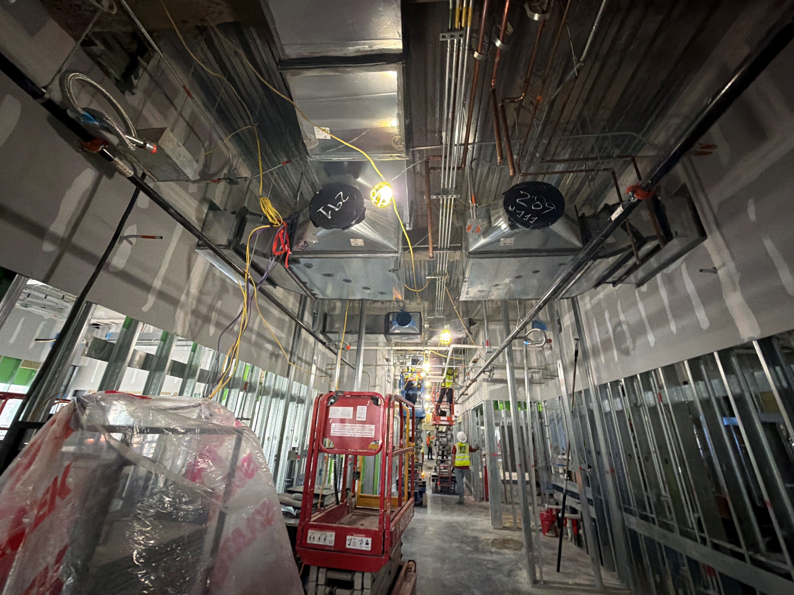
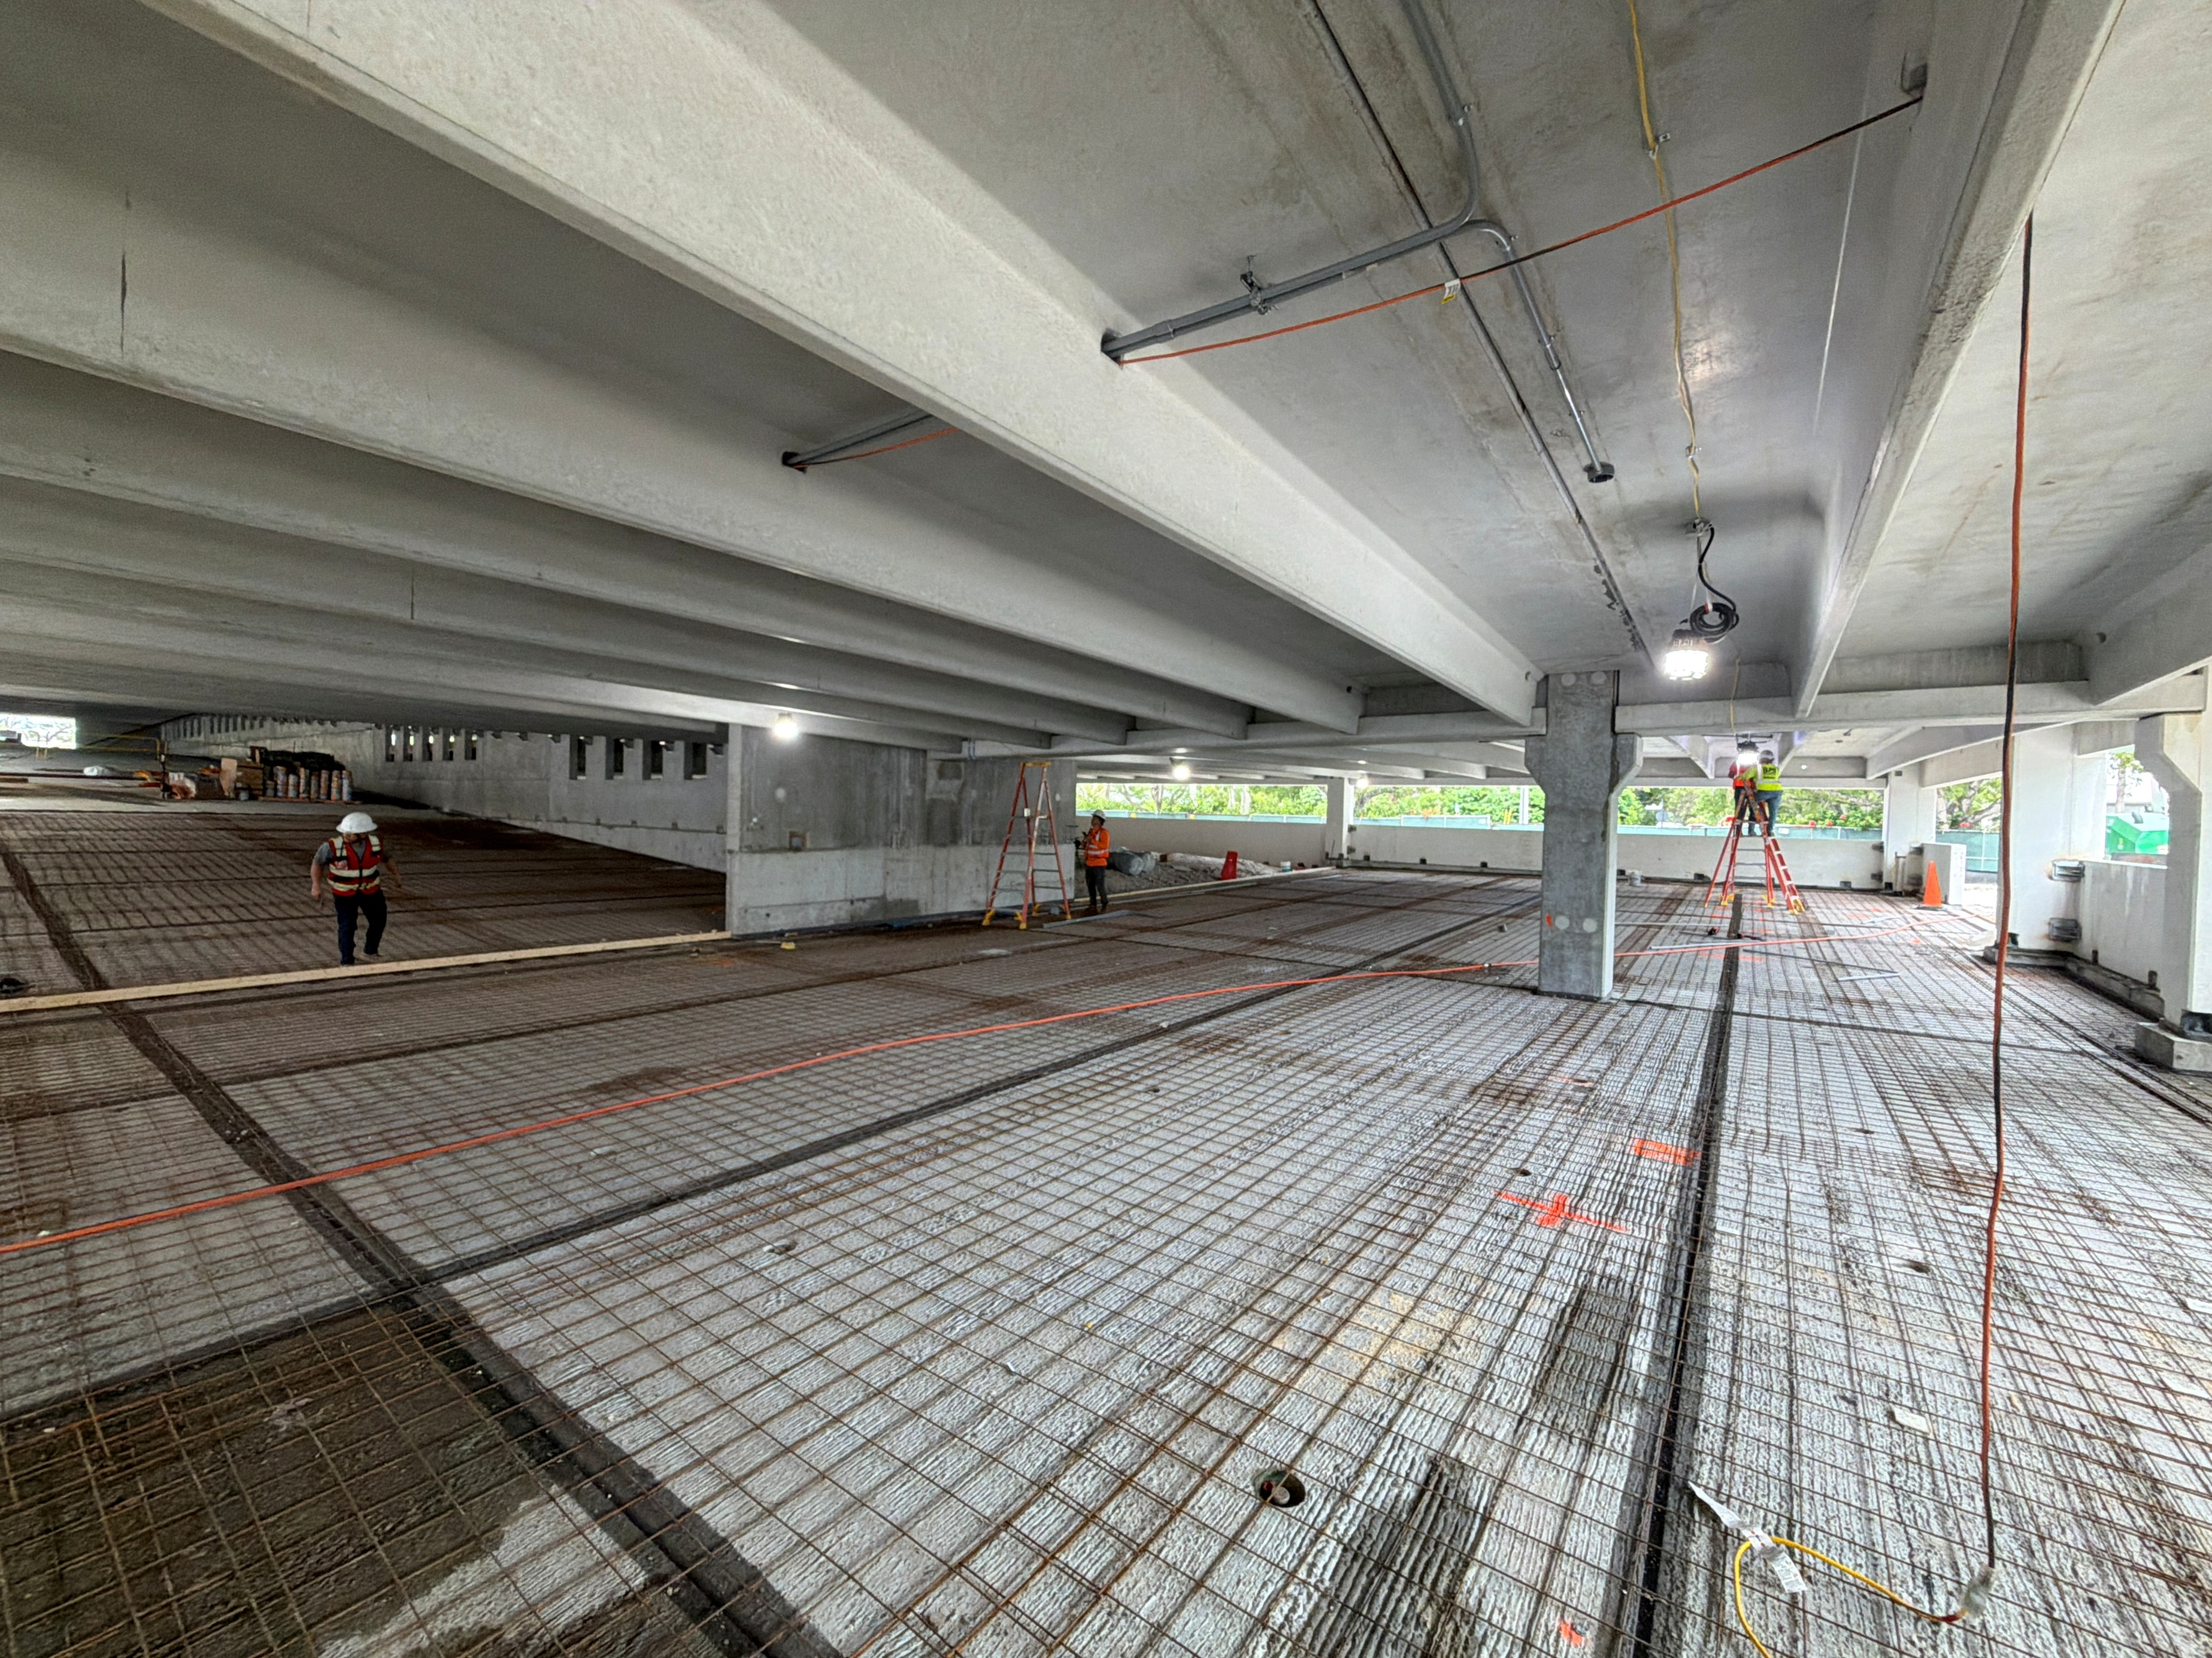
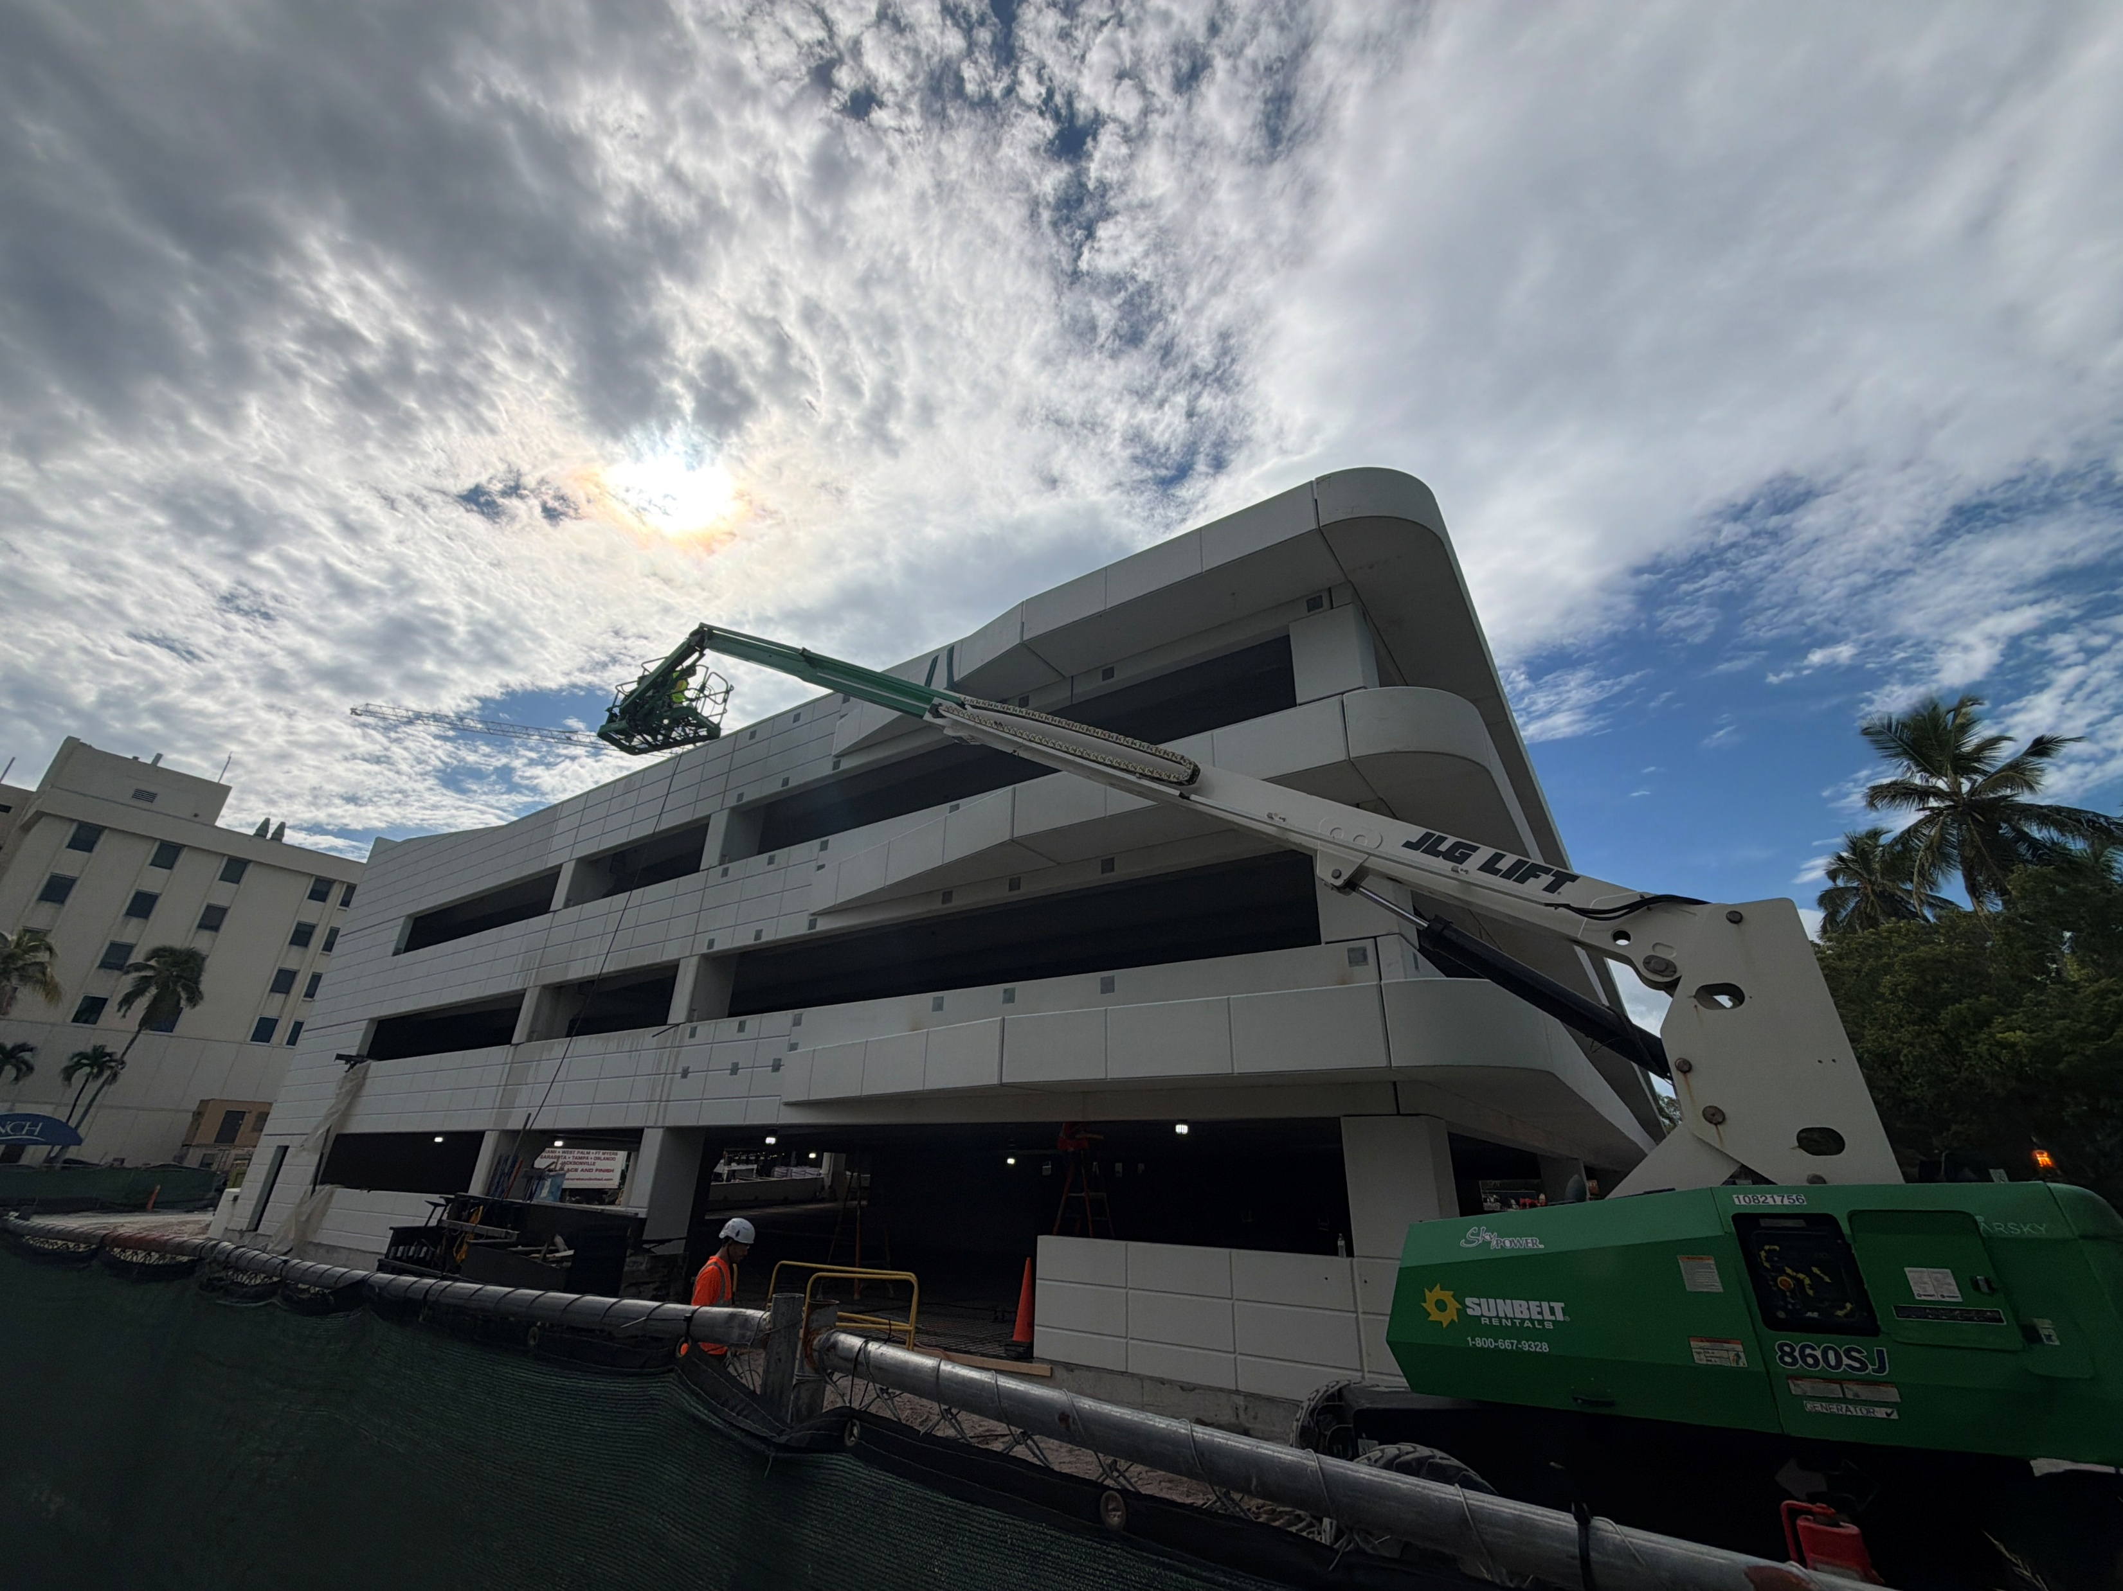
Schedule Update

Slide 8
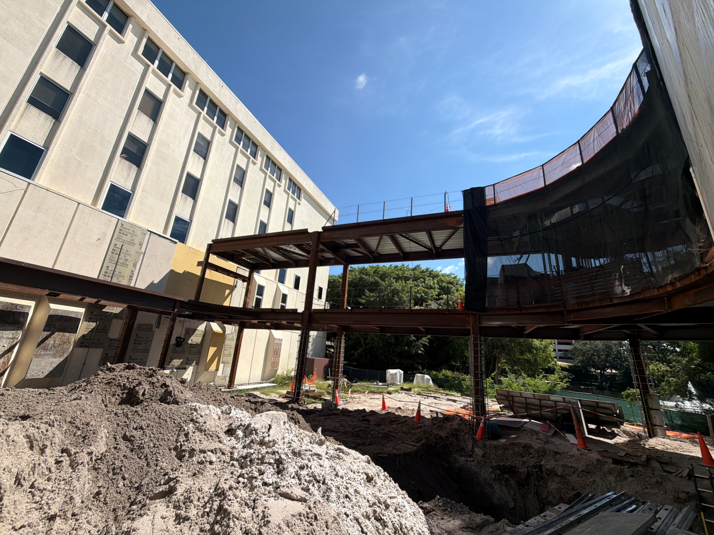
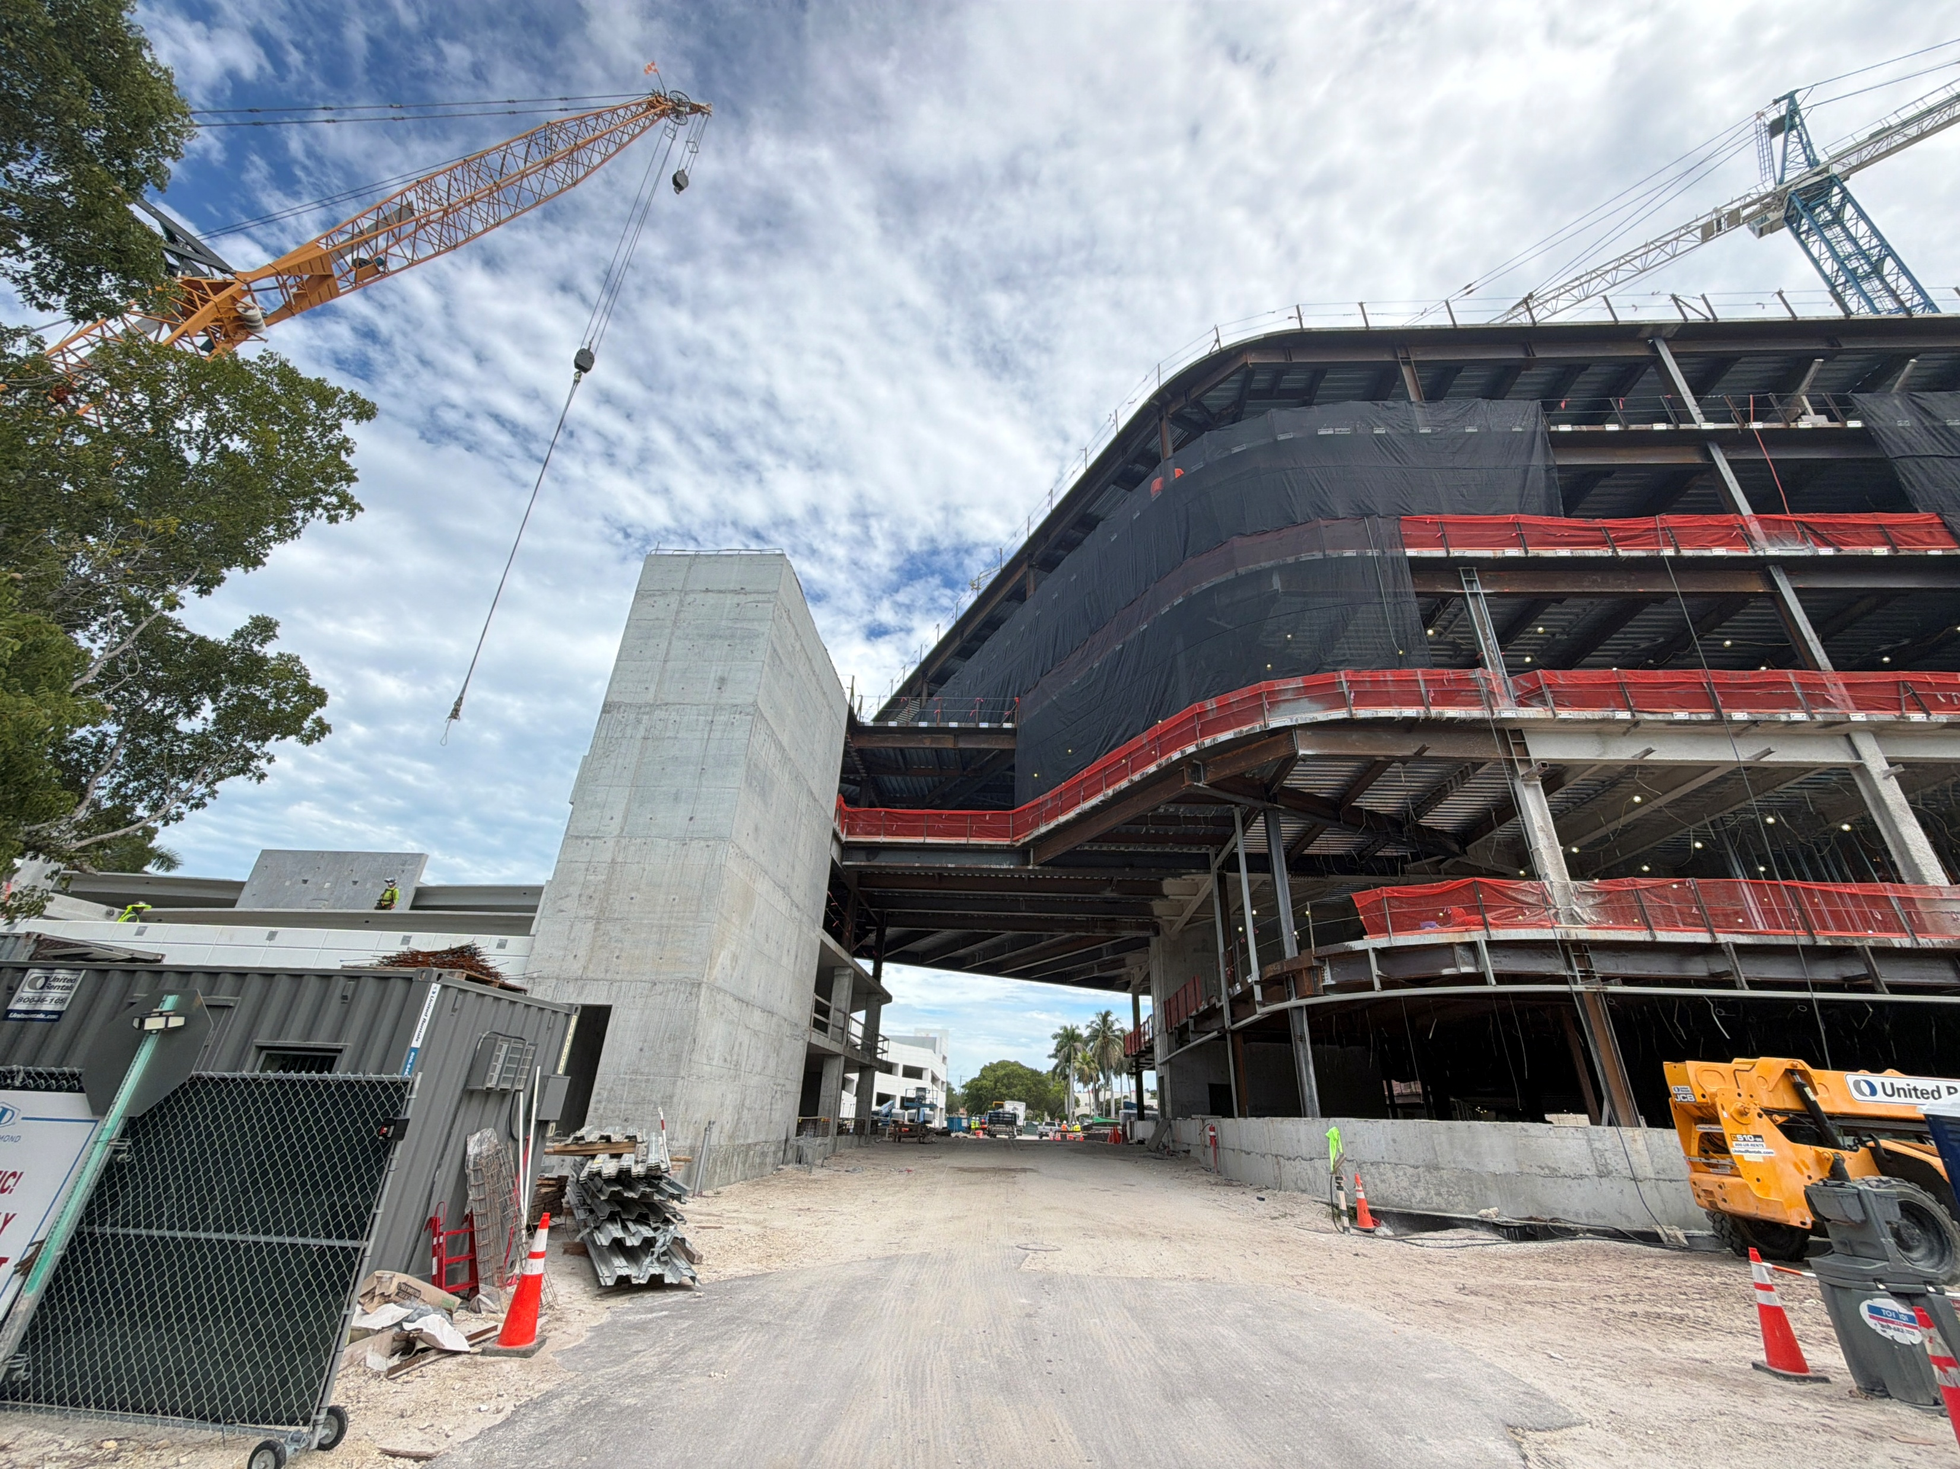
Current Construction Schedule Milestones
(Subject to Change)
Parking Garage
  Precast structure erected – 3rd quarter 2026
  MEP systems & Elevator install – 4th quarter 2026
  Landscaping installation – 4th quarter 2026
  (installation will occur in multiple phases)
  Parking Garage operational – 1st quarter 2027 (levels 1 & 2)
Heart Vascular & Stroke Institute
  Steel erection complete - 3rd quarter of 2026
  Exterior enclosure – 1st quarter of 2027
  Interior finishes – 1st quarter of 2027 to 3rd quarter of 2027
  Install elevators – 2nd quarter of 2027
  Permanent Power – 2nd quarter of 2027
  Commissioning of MEP Systems - 3rd quarter of 2027
  Building construction complete – 3rd quarter of 2027
  NCH activation phase – 4th quarter of 2027

Slide 9
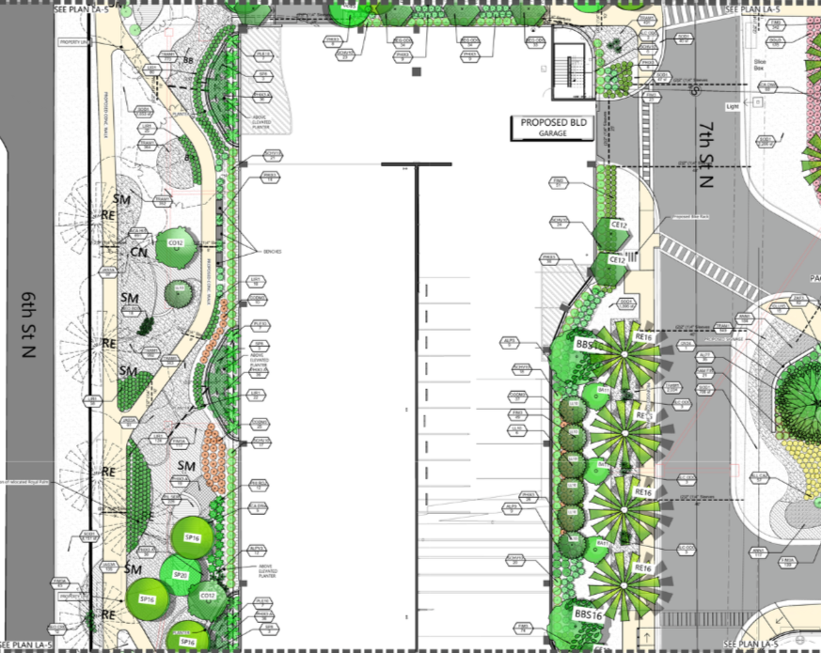
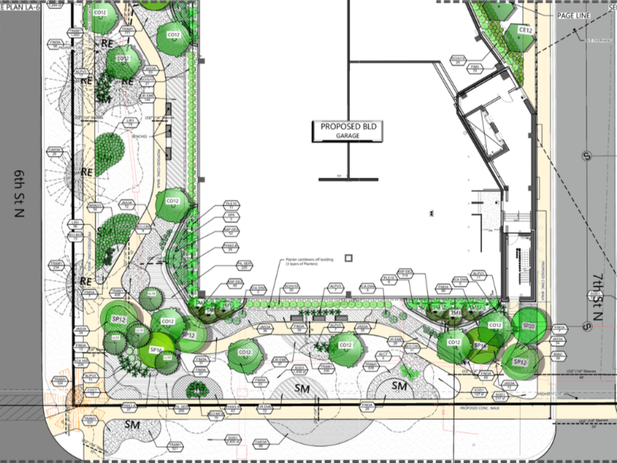
Landscaping Update
Parking garage landscaping installations will occur over the next 3-4 +/- months
  The landscaping trade contract will be finalized in October of 2026.
  Ground floor planters will be constructed over the next 2 months. Soil placement will follow by the landscaper.
  Perimeter sidewalks will be installed this fall / winter.
  Landscaping and site lighting will follow

Slide 10
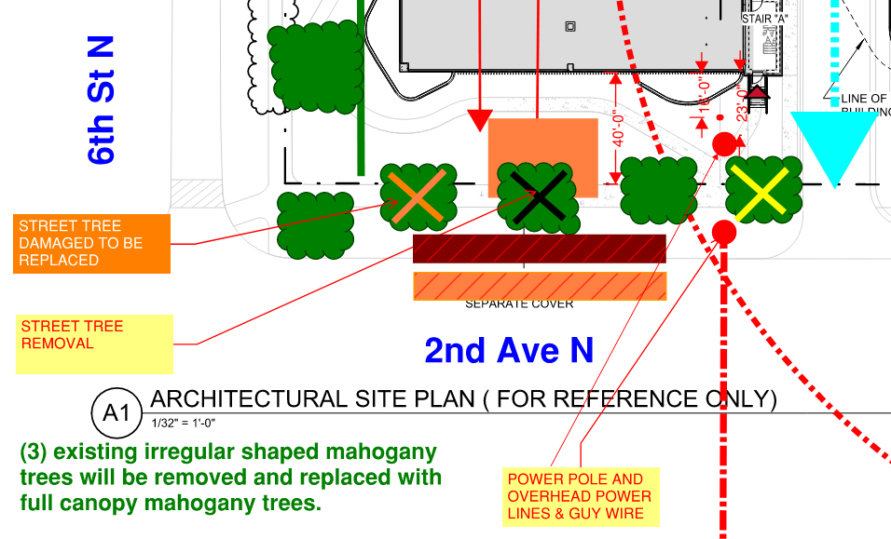
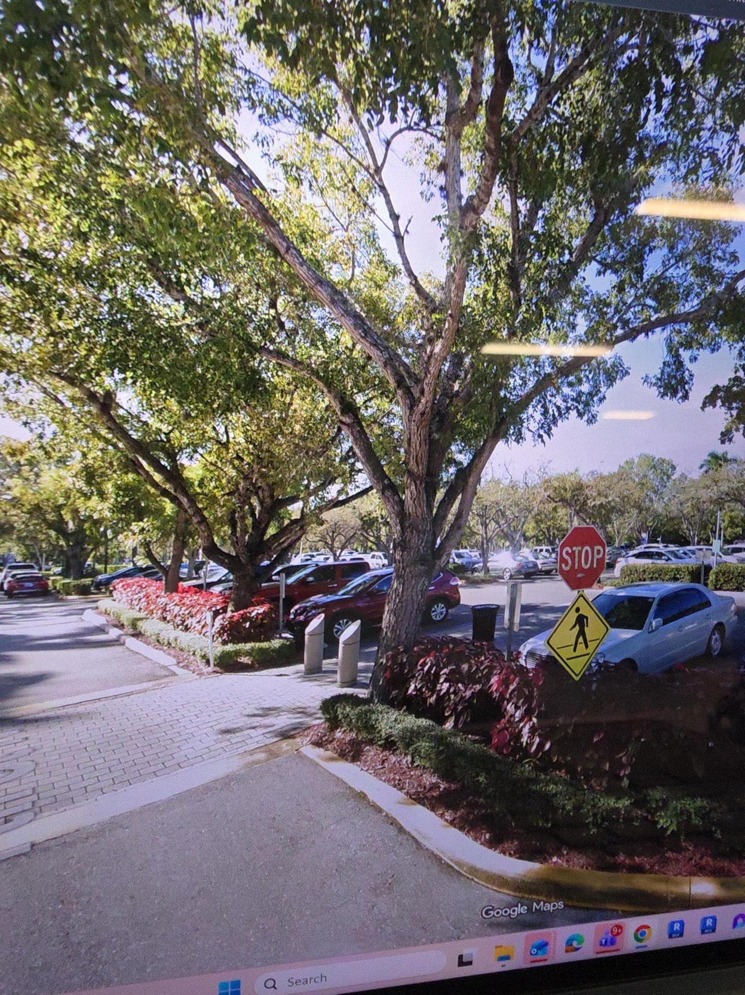
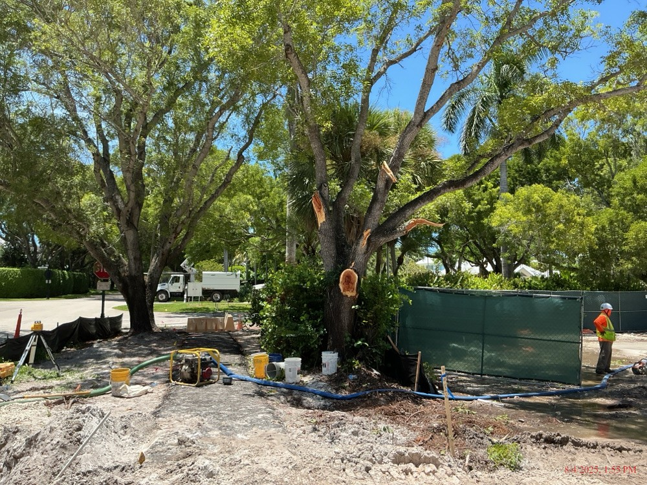
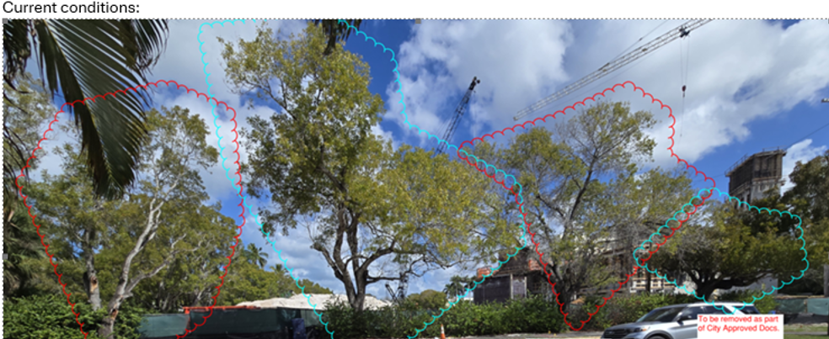
Update on 2nd Ave N Tree Transplant work
2nd Ave N Tree Improvements
  (3) existing Mahogony trees will start to be prepped along the main entrance of the existing hospital for transplant.
  The actual transplant work won’t occur until 2-3 months of root pruning work is performed on the existing trees.
  The transplanted trees will be installed in Jan- Feb along 2nd Ave.

Slide 11
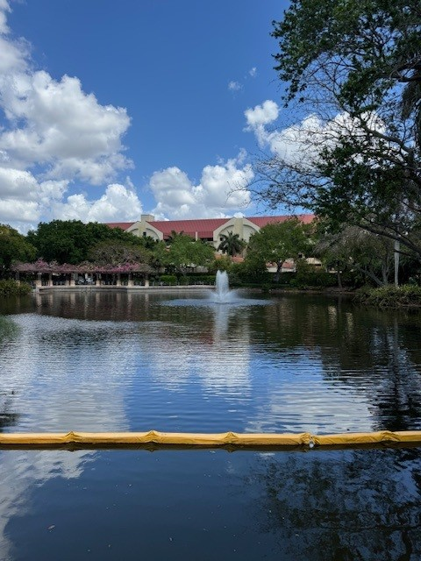
Lake Update
Lake Condition Updates
  The lake will be treated to reduce the amount of nutrient levels and organic material that has accumulated on the bottom.
  The treatment process was reviewed and accepted by the City of Naples.
  No adverse effects are anticipated with the aquatic life within the lake.
  One treatment will be applied per month for (2) months.
  Water samples will be taken before and after the application.
  The treatment process will occur this fall.

Slide 12
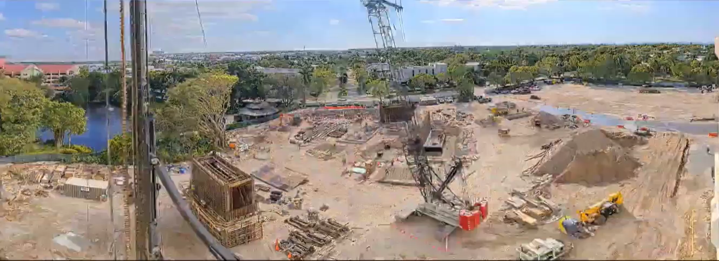
Construction progress video

Slide 13
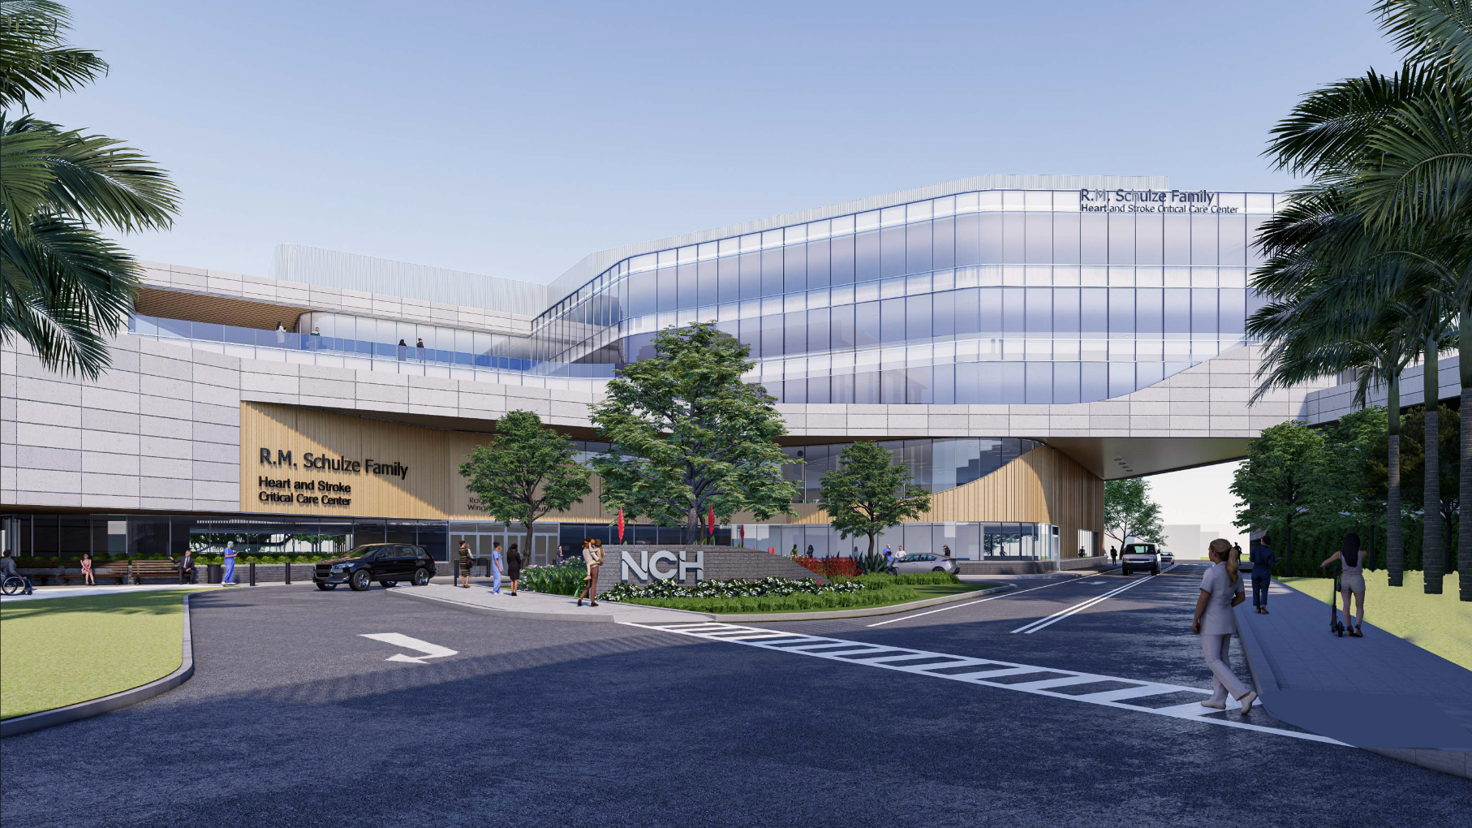

Slide 14
To learn more visit :
criticalcareinnaples.com
Project Contact Information
Matt Holliday
neighbors@nchmd.org
239-826-7864

Slide 15
THANK YOU

